Slide 1

Control OS by hand gesture
Dr. Salwa Osama

Slide 2





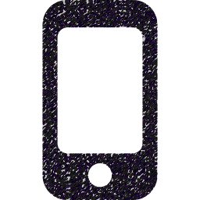
Life cycle of Mobile & PC
WiFi
Server
Client

Slide 3
Server Side
This program creates a small server on the computer that listens for commands sent from a mobile phone over WiFi.
The mobile app sends the word "NEXT" when a specific gesture is detected.
When the computer receives this word, it automatically presses the right arrow key, which moves the PowerPoint presentation to the next slide.

Slide 4
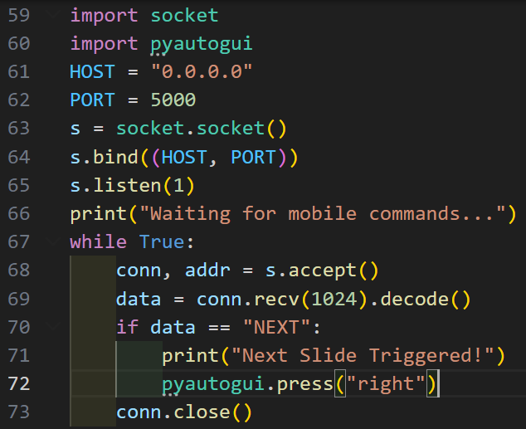
Server Side
socket: enables WiFi communication between phone and PC
pyautogui: simulates keyboard/mouse actions

Slide 5
Server Side
The host is the IP address the server binds to.
127.0.0.1 or localhost: loopback — accept only local connections
.0.0.0.0: bind to all network interfaces — accept connections from any local network interface.
Specific IP (e.g., 192.168.1.10): bind to that interface only.

Slide 6
Server Side
Port is the channel number (0–65535) used to identify the service on the machine.
Well-known ports: 0–1023 (privileged).
Choose a port >1024 for local apps to avoid requiring admin privileges.

Slide 7
Server Side
socket(): creates server object
bind(): attaches server to IP + port
listen(1): waits for one device at a time

Slide 8
Server Side
Waits for the mobile to connect
Returns:
conn: communication channel
addr: mobile IP address

Slide 9
Server Side
Receives up to 1024 bytes
Converts data to text

Slide 10
Server Side
If the received string equals "NEXT" the server prints feedback and calls pyautogui.press("right"), which simulates the Right Arrow key on the PC.

Slide 11
Server Side
Ends communication
Server returns to waiting mode

Slide 12
Client Side
This mobile application uses the accelerometer sensor inside the phone to detect hand movements such as raising the hand or waving.
When a wave gesture is detected, the phone sends a command to the PC to move to the next PowerPoint slide.

Slide 13
Client Side
The mobile phone has an accelerometer sensor that detects movement.
The sensor gives 3 values:
X → left/right movement
Y → up/down movement
Z → forward/backward movement
The app constantly reads these values.
The app identifies:
Raise Hand → if Y value becomes high
Wave Hand → if X value changes quickly back and forth
When a wave is detected, the phone sends a message "NEXT" to the PC through WiFi.
The PC receives the message and changes the PowerPoint slide.

Slide 14
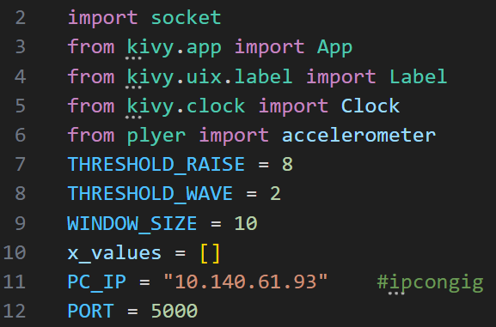
Client Side
import socket — imports the socket module to allow network communication
.App — main class for creating a Kivy application
.Label — UI element to display text on screen
.Clock — schedules repeated function calls
.accelerometer — accesses phone motion sensor values.

Slide 15
Client Side
THRESHOLD_RAISE — minimum Y-value to detect a hand raise.
THRESHOLD_WAVE — minimum X-difference to detect waving.
WINDOW_SIZE — number of motion samples used for analysis.
x_values — list storing the last X-axis readings.

Slide 16
Client Side
PC_IP — the computer’s IP address that the phone connects to.
PORT — the TCP port number used for sending commands.

Slide 17
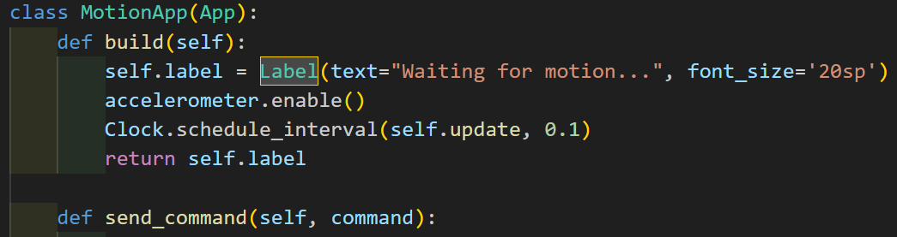
Client Side
Creates a label to show status messages.
Enables the accelerometer sensor.
Schedules the update() function to run every 0.1 seconds.
Returns the label to be shown on screen.
Clock.schedule_interval(...) This means run something again and again on a fixed time interval. It is like a loop, but controlled by time.
2. self.update This is the function that will be called. So, every 0.1 seconds, Kivy will run the update() function of your class.
3. 0.1 This is the time interval in seconds.
So: 0.1 seconds = 100 milliseconds
The update() function is executed 10 times per second.

Slide 18
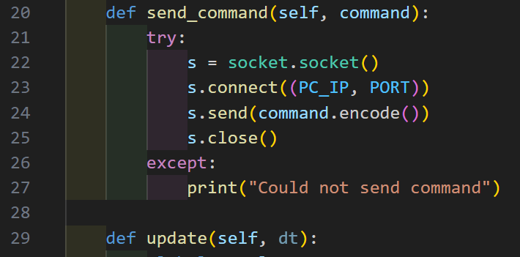
Client Side
Creates a new socket.
Connects to the computer’s IP and port.
Sends the command encoded as bytes.
Closes the connection.
Prints an error message if sending fails.

Slide 19
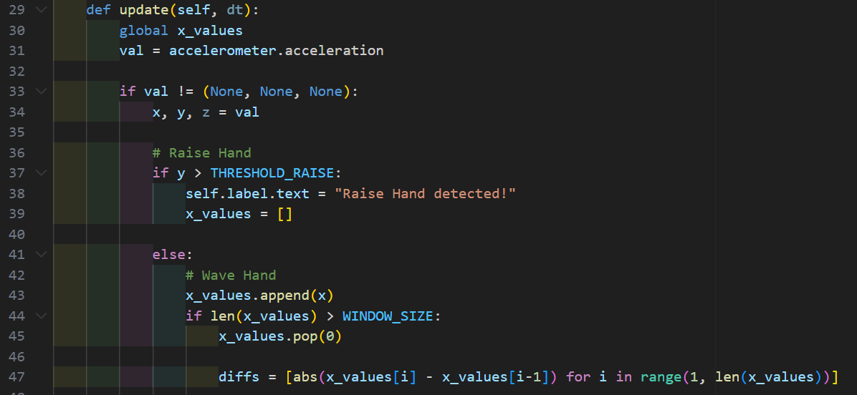
Client Side
update() runs every 0.1 seconds.
Reads accelerometer values (X, Y, Z).

Slide 20
Client Side
If the sensor values exist:
  Extract X, Y, Z.
If Y > 8 → detect "hand raise".
Clears previous X-axis values.

Slide 21
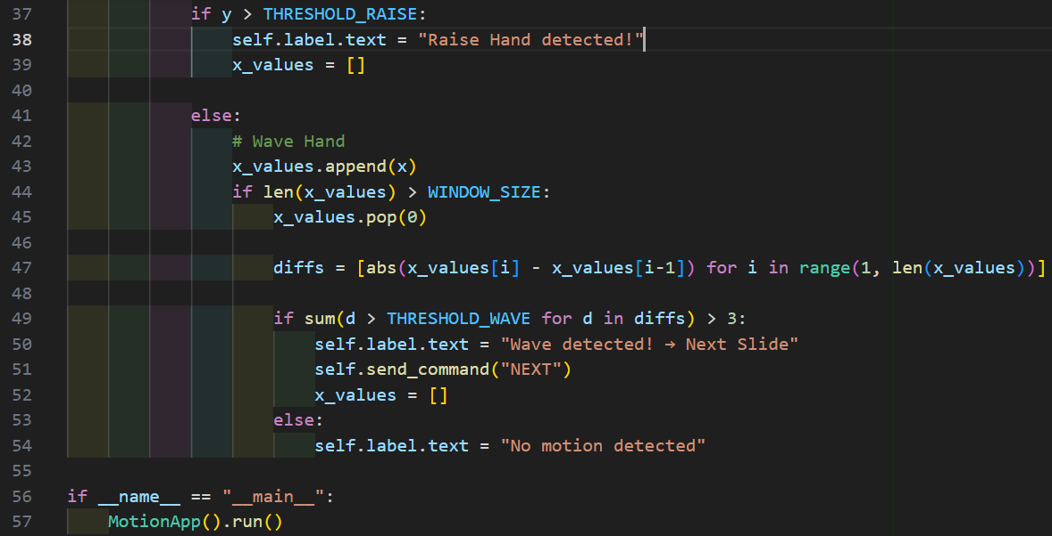
Client Side
Every time a new value x comes from the sensor, we store it in the list x_values.

Slide 22
Client Side
If the list becomes larger than a predefined window size (ex: 10 values), delete the oldest value.
This keeps the list small and only stores recent motion.

Slide 23
Client Side
This tells us how big the movement is.

Slide 24
Client Side
Count how many times the movement (difference) is bigger than THRESHOLD_WAVE
If this happens more than 3 times, we consider it a wave gesture

Slide 25
Client Side
So if a wave is detected:
Update the label on the screen
Send a command "NEXT" to go to the next slide
Reset the values list for fresh detection
Means all movements are small → not enough to be considered a wave.

Slide 26
Thanks

